Slide 1

Video Surveillance System
30% Presentation Template
Nabeel Saleem CIIT/FA20-BSE-122/ATD
Hammad Ur Rehman CIIT/FA20-BSE-126/ATD
Zain Asif CIIT/FA20-BSE-136/ATD
Supervisor-name:
Dr. Saad Mustafa
Department of Computer Science
COMSATS University Islamabad, Abbottabad Campus

Slide 2
Agenda of the Presentation
Brief Introduction
Scope
Functional Requirements
Non-Functional Requirements
User Goals
Use Case Diagram
Class Diagram
Sequence Diagram
System Sequence Diagram
Activity Diagram
JSON Tree
Package Diagram
DeploymentDiagram

Slide 3
Brief Introduction
We are developing a AI system which ensures the safety of people by detecting the violence or suspicious activity. It divides the video in chunks and the feed them into Deep Learning model which is trained on our dataset . Then our model process the video and provide results of video and notify to authorized users.

Slide 4
Scope
The proposed project Video Surveillance System will be an android based application.
The admin will create users , Remove user upload video, get notification , view history.
Only registered users will see the abnormal activities in application.
System provides violence results to register users.
The system will allow upload video for violence detection.
Detection
System should only detect violent activities related to define classes that are Shooting and Explosion.
System will only detect violence activities when camera work properly

Slide 5
Server Related Activities
We will use Django framework for interaction between Application and model.
API : Django REST Framework to handle video uploads, user registration, and AI model integration.
Notification System : Use Django signals or third-party packages like Django Channels to trigger notifications on violent activity detection.
Violence Detection Integration: Integrate our AI model into Django views to process video chunks and detect violence.

Slide 6
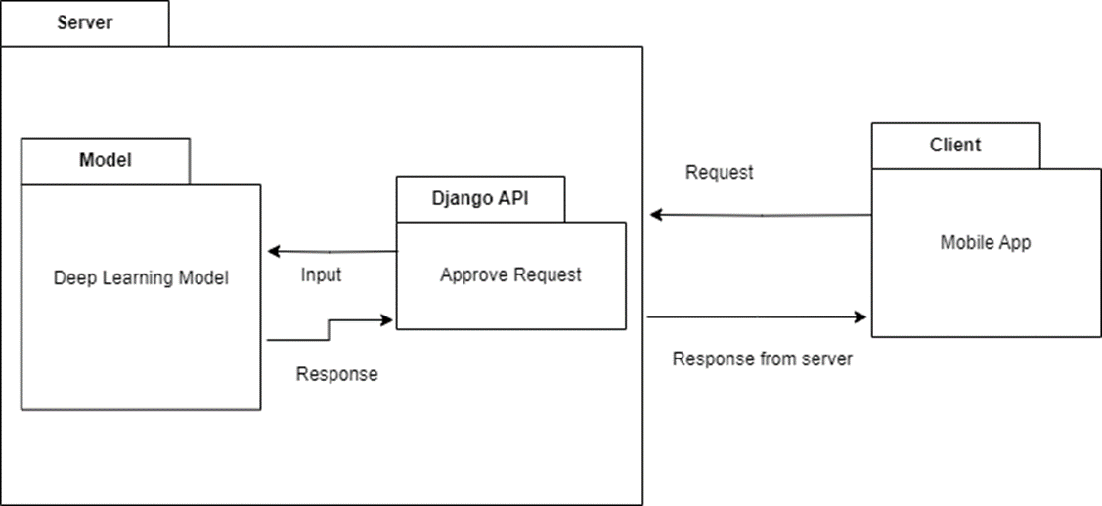
Deployment Architecture

Slide 7
Our Scope will not include:
System will not detect violence in dark.
System will not detect every abnormal activities in the environment.
Delay can occur due to high throughput.
Our System could not deal with Audio Violence.
Performance may vary based on the quality and positioning of camera.
Changes in weather conditions or cluttered backgrounds may affect the accuracy of system.

Slide 8
Functional Requirements
FR01-Admin will be able to sign up and login using their credentials.
FR02-Admin will create users accounts.
FR03-Admin will remove users accounts.
FR04-System will be allow the user to login to system using username and password provided by admin.

Slide 9
Functional Requirements
FR05-User will upload video from gallery
FR06-System will detect violence activity.
FR07-User will see the violence clip from uploaded video.
FR08-System will provide violence notification.
FR9-User will see violence activity notification.

Slide 10
Non-Functional Requirements
NFR 1 : Usability
User Interface (UI): The application should have an intuitive and user-friendly interface, allowing easy navigation for both administrators and registered users.
Accessibility: The system should be accessible to all users ensuring that the registration process and violence detection results are easily understandable

Slide 11
Non-Functional Requirements
NFR 2 : Performance
Response Time: The system should provide real-time notifications, ensuring that authorized users receive alerts upon the detection of violent incidents.
Throughput: The application should handle a reasonable (i.e. 5 video at a time) of video uploads and processing simultaneously without significant degradation in performance.
Scalability: The system should be scalable to accommodate an increasing number of registered users and uploaded videos without compromising performance.

Slide 12
Non-Functional Requirements
NFR 3: Security
Authentication and Authorization: User authentication and authorization mechanisms should be robust to ensure that only authorized personnel can access the system and receive notifications.

Slide 13
Non-Functional Requirements
NFR 4 : Maintainability
Modularity: The system should be modular, allowing for easier updates and maintenance of individual components without affecting the entire application.

Slide 14
Non-Functional Requirements
NFR 5 : Interoperability
API Compatibility: The system should support integration with external APIs for future enhancements or collaboration with other security systems.
Data Exchange: The application should facilitate data exchange with other authorized security systems if necessary.

Slide 15
User Goals
The Goal of the user is to know any violence activities in the provided footage. That will save user time and money. User can get real time notification of any violence activities and also view the history of violence activities.

Slide 16
Use Cases
Add User
Remove User
Login
Upload video
Receive Notification
Detect Violence
Live Detection
View History
Logout

Slide 17
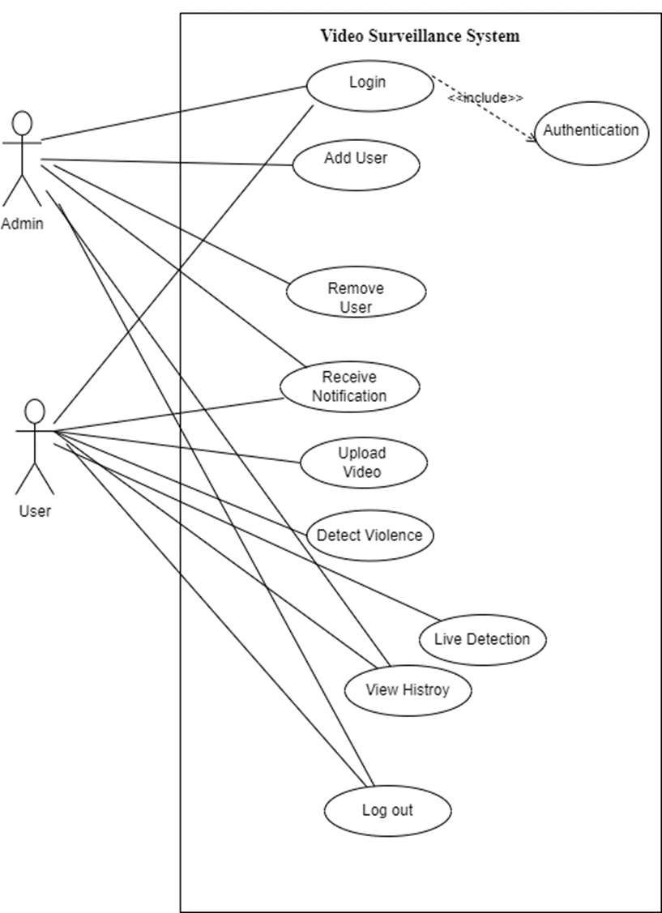
Use Case Diagram

Slide 18
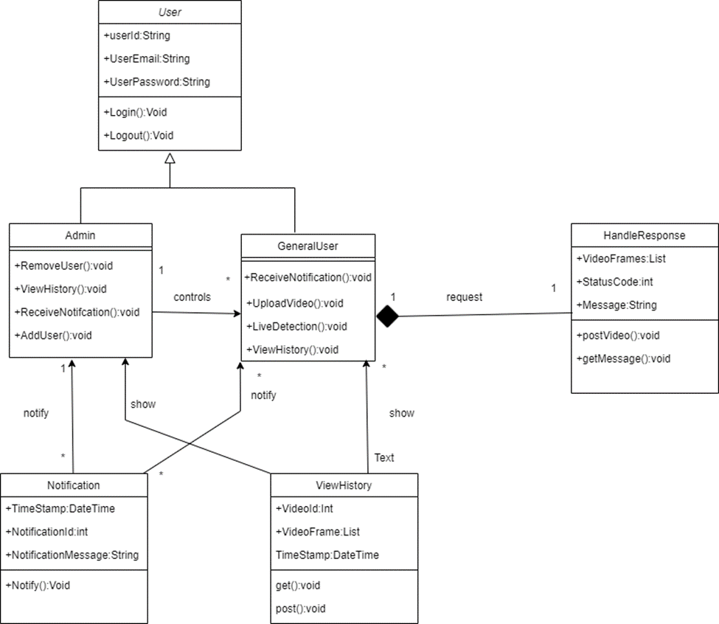
Class Diagram

Slide 19
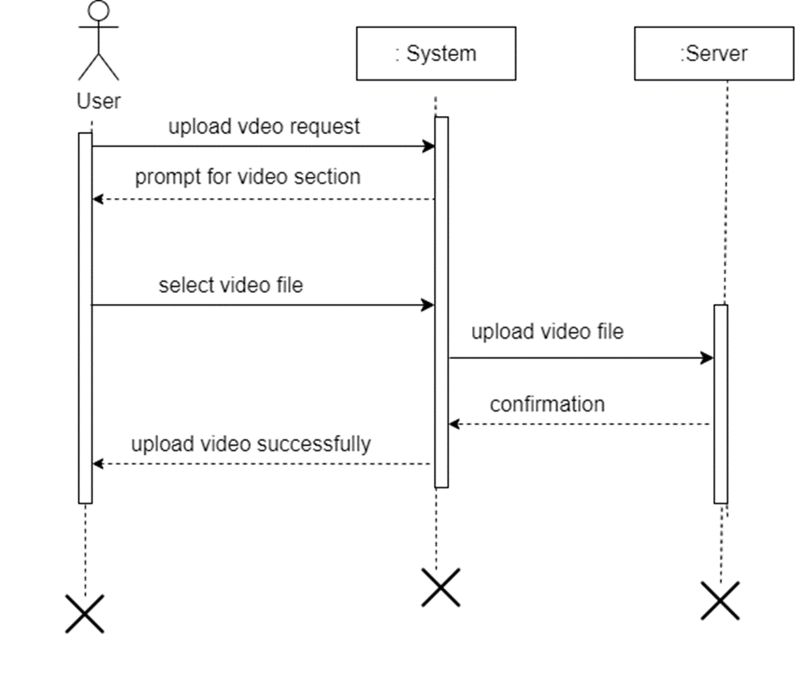
Sequence Diagram
Upload Video

Slide 20
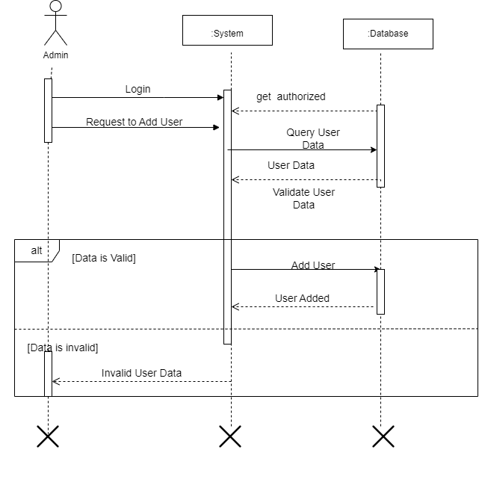
Add User Sequence Diagram:

Slide 21
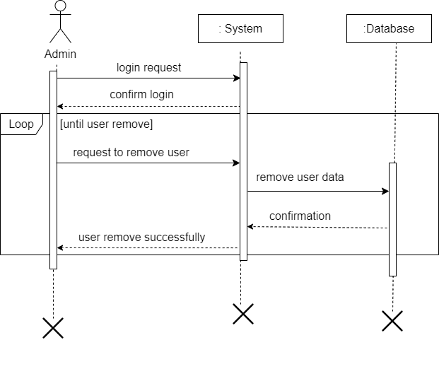
Remove User Sequence Diagram:

Slide 22
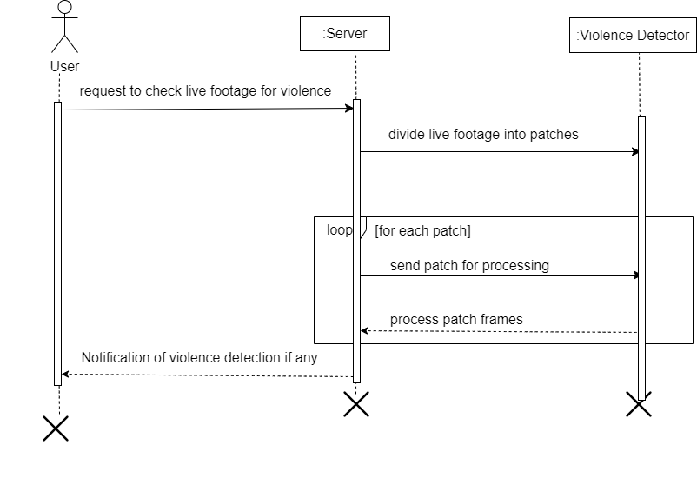
Live Detection Sequence Diagram:

Slide 23
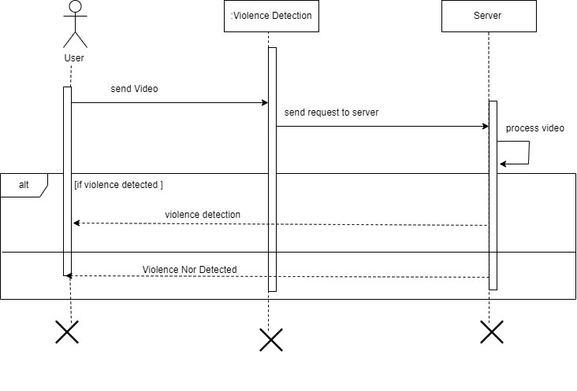
Violence Detection Sequence Diagram

Slide 24
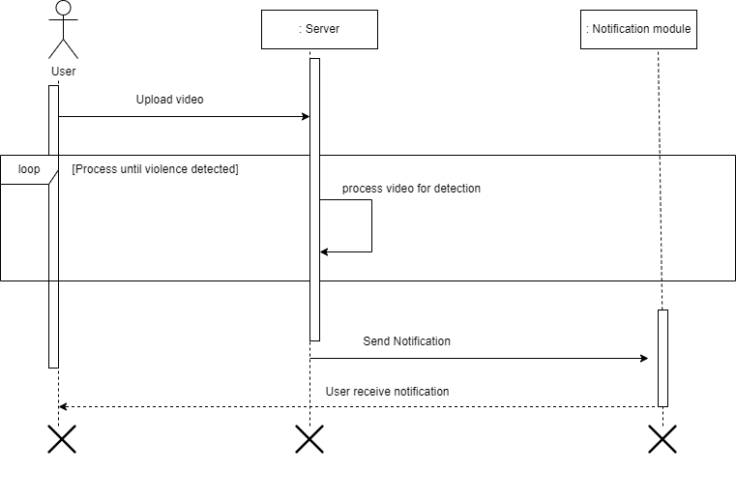
Notification Sequence Diagram:

Slide 25
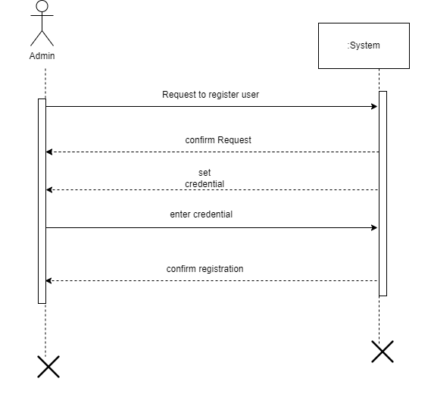
System Sequence Diagram
User System Sequence Diagram:

Slide 26
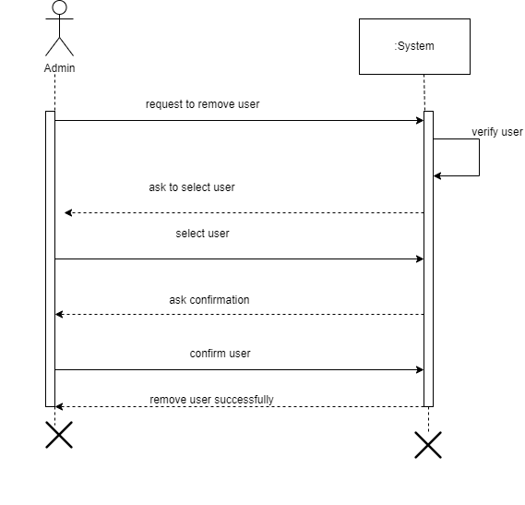
Remove User :

Slide 27
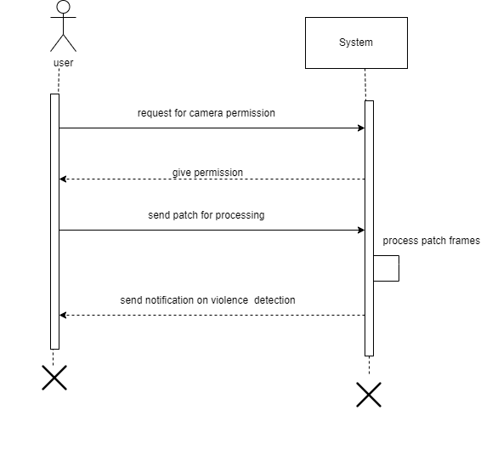
Live Detection

Slide 28
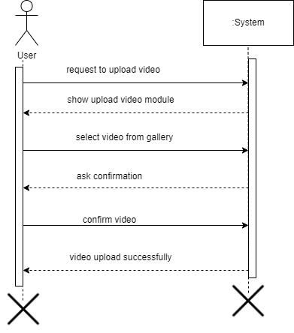
Upload Video

Slide 29
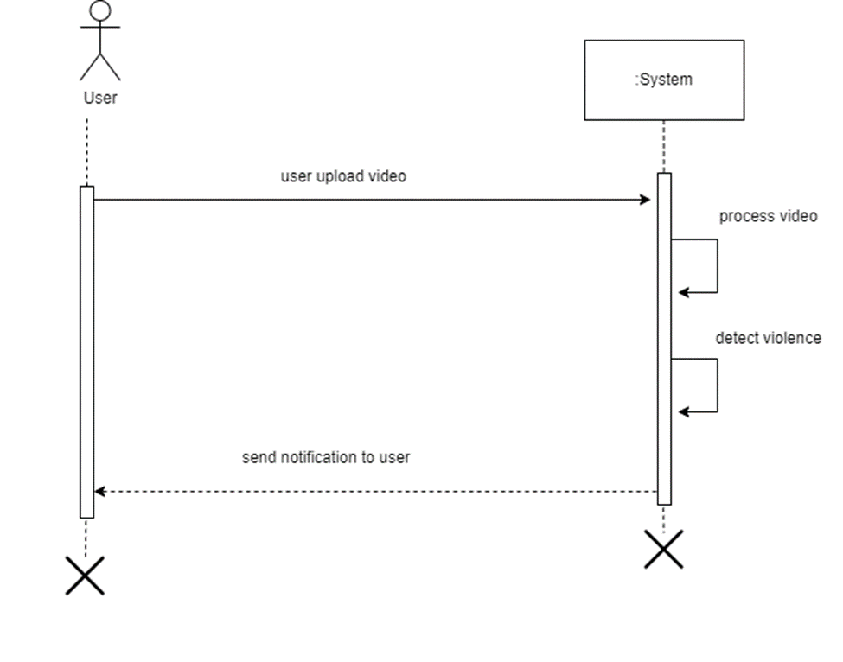
Notification

Slide 30
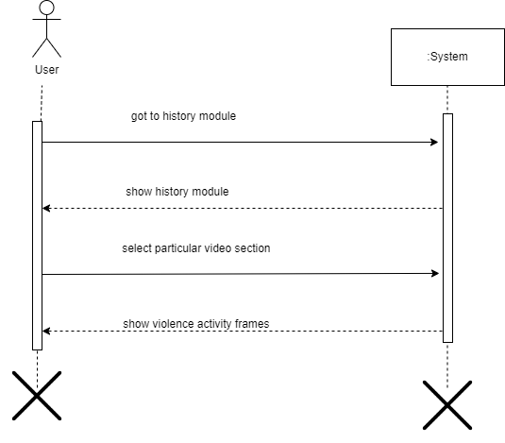
View History

Slide 31
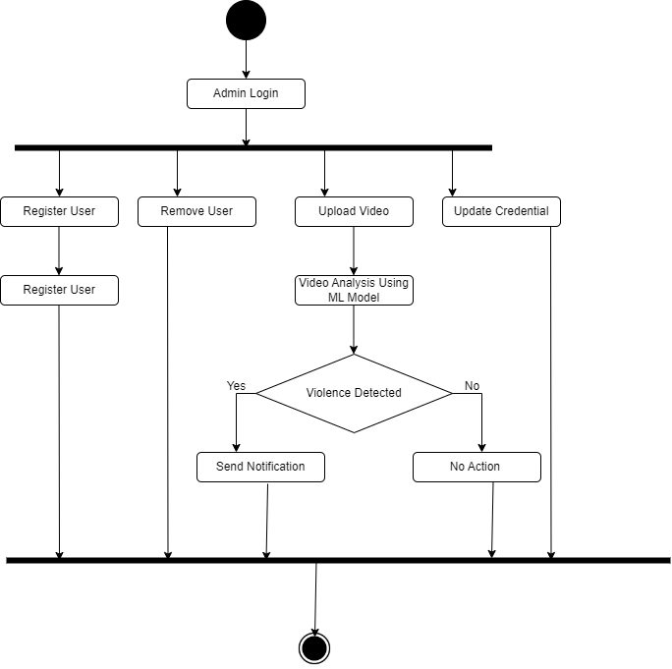
Activity Diagram
By Admin Perspective:

Slide 32
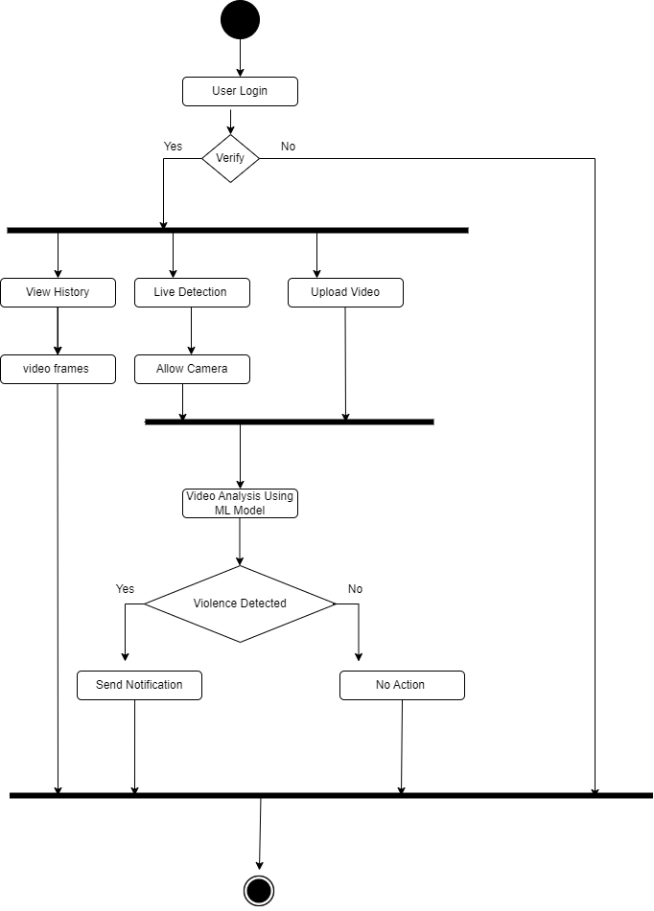
Activity Diagram
By User Perspective:

Slide 33
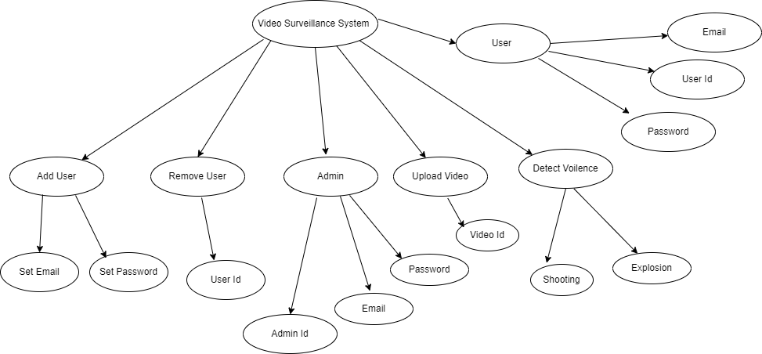
JSON Tree

Slide 34
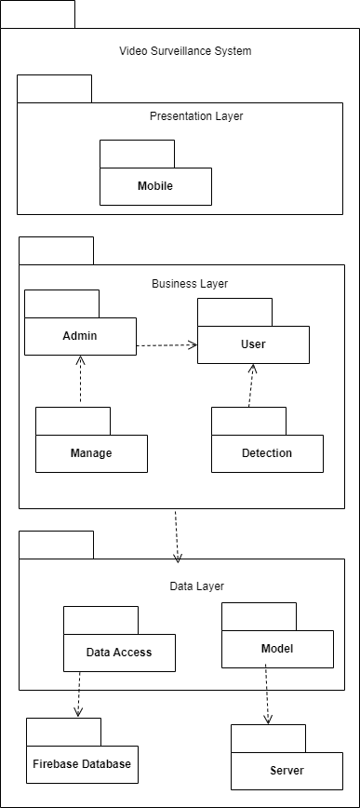
Package Diagram

Slide 35
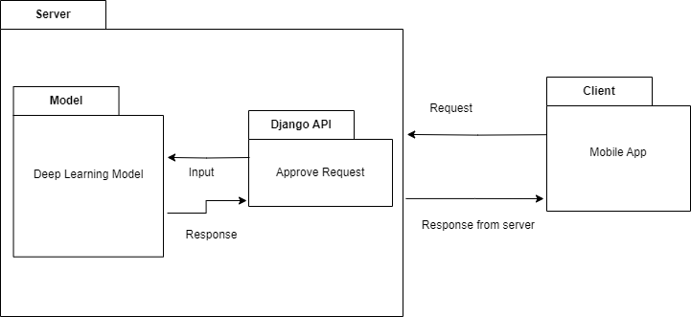
Deployment Architecture

Slide 36
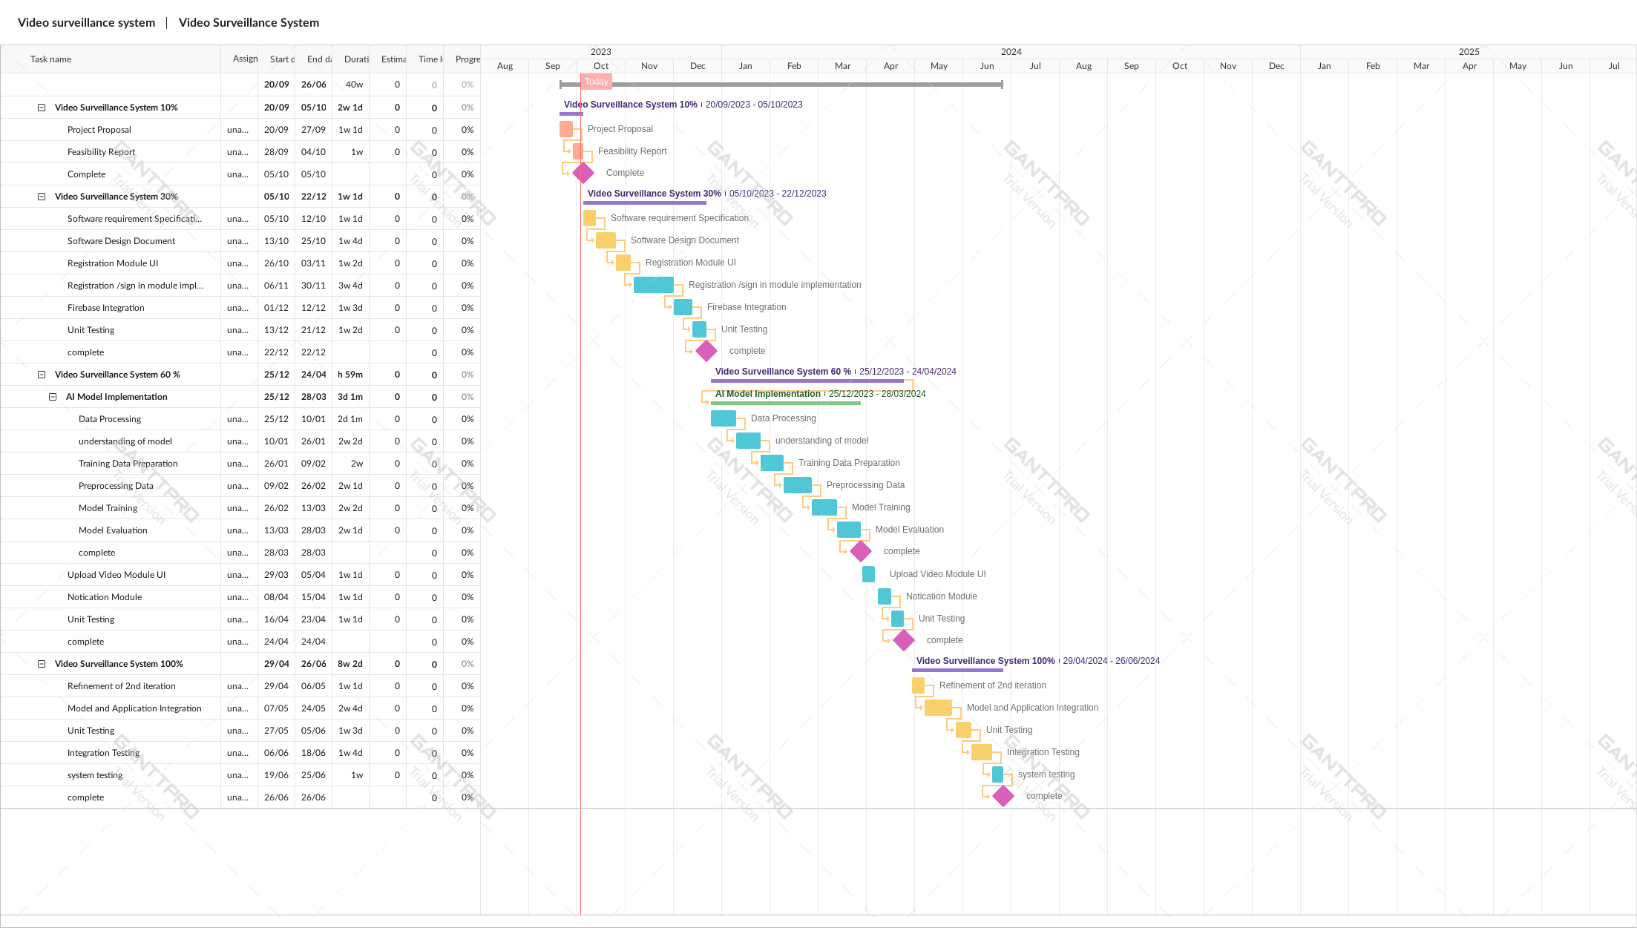
Schedule
Gantt Chart (using any project management tool)

Slide 37
Details of 1st Iteration (30%)
As per Gantt chart we have completed the following tasks:
Identify Model
Train Model
SRS
SDD

Slide 38
Details of 2nd Iteration (60%)
As per Gantt chart we will complete the following tasks:
Login/Sign-up Authentication
Add User Module
Remove User Module
Notification Module
View History Module
Upload Video from Gallery Module
Improve model

